Slide 1


WELCOME
MADE BY - PRIYANSHU
CRN - 2221132

Slide 2
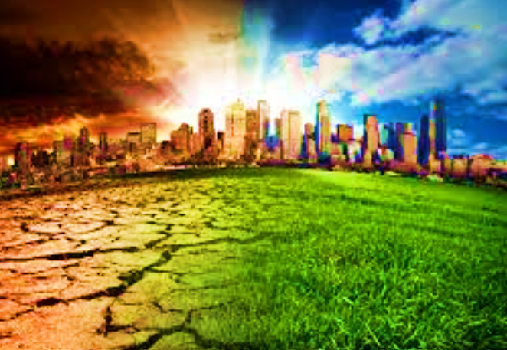
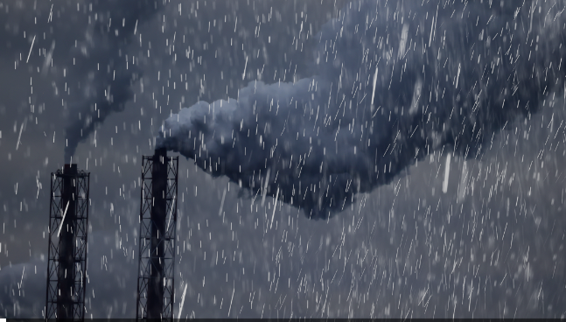
CONTENT TODAY
Climate Change
Acid Rain

Slide 3


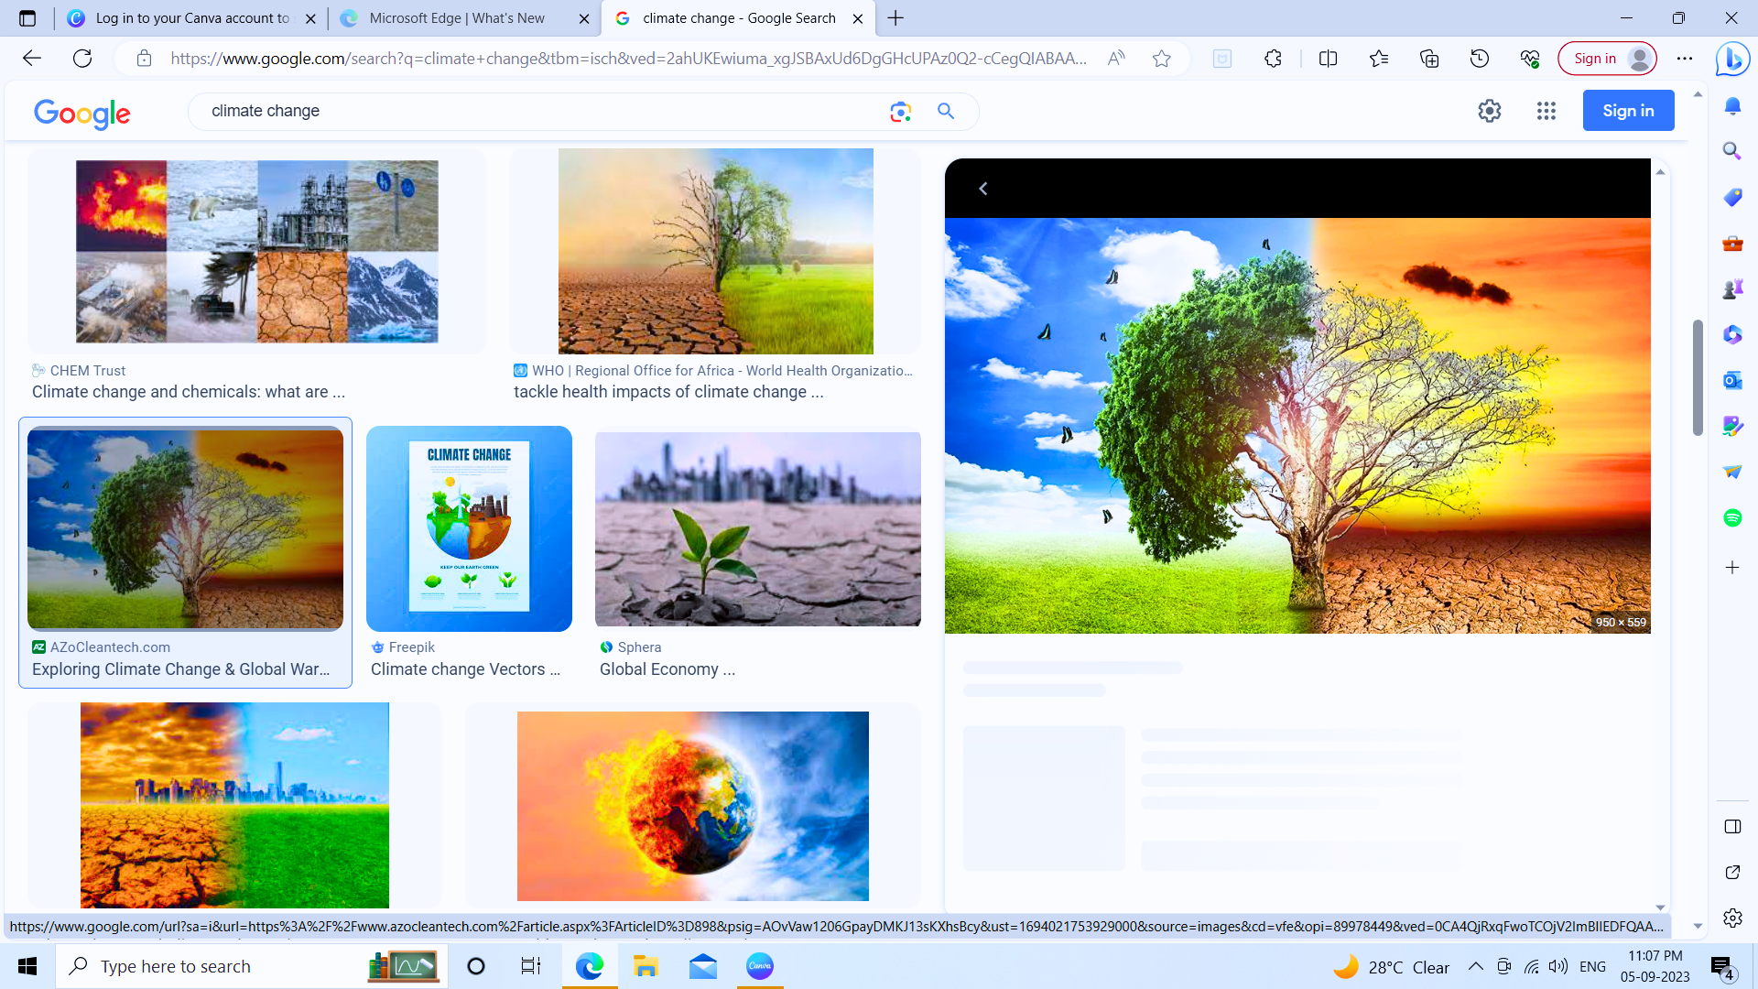

CLIMATE CHANGE : CAUSES , EFFECTS AND SOLUTIONS!

Slide 4

“FIRST OF ALL,YOU ALL SHOULD KNOW THAT WEATHER AND CLIMATE ARE NOT SAME THING?”

Slide 5
Difference between Weather and Climate
1) Weather is study of atmosphere conditions for a short period of time.
2) Short term phenomenon.
3) It changes frequently .
4) It depends on smaller areas likes district or state.
1) Climate is study of the average weather condition observed over a long period of time.
2) Long term phenomenon.
3) It does not change frequently.
4) It depends on a larger area like state or country.

Slide 6
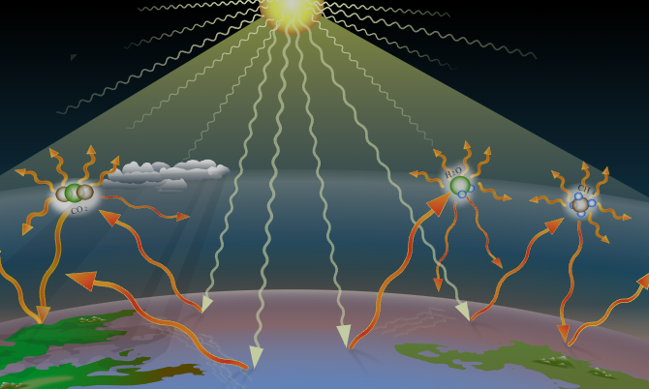
GREEN HOUSE EFFECT
“Greenhouse effect is the process by which radiations from the sun are absorbed by greenhouse gases and not reflected back into space.”
This causes rise the temperature of earth. By this Greenhouse effect Global Warming occurs.

Slide 7
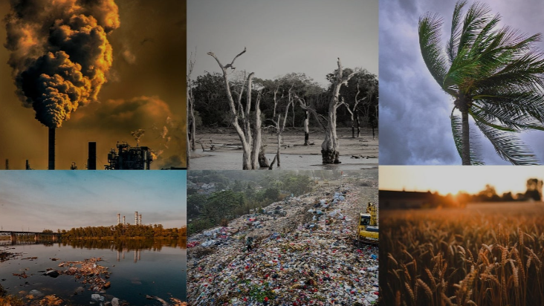
CAUSES OF CLIMATE CHANGE
Global Warming
Burning fossil fuel
Deforestation
Manufacturing goods
Agriculture
Transportation

Slide 8
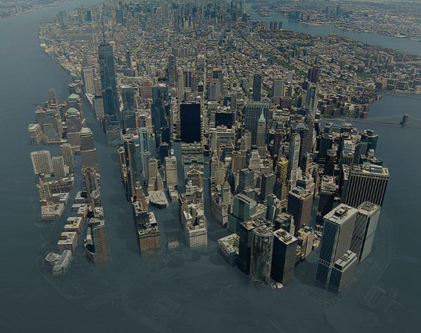
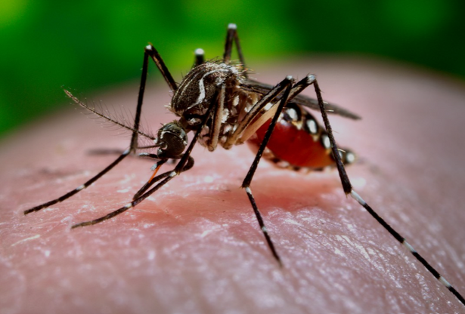
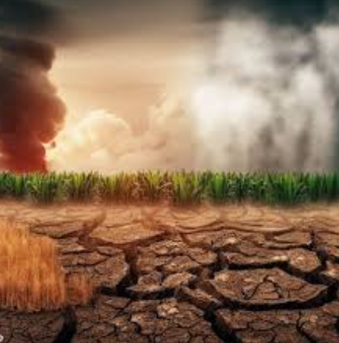
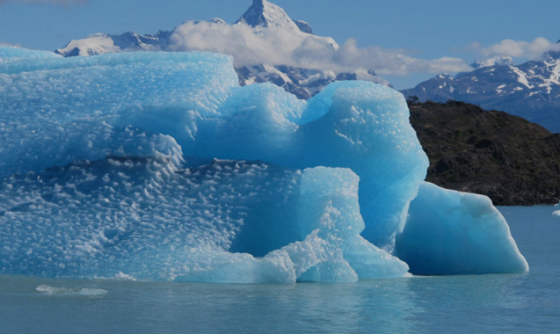
EFFECT ON ECOSYSTEM
Temperature changes
Melting ice
Sea level rise
Loss of biodiversity
Impact on agriculture

Slide 9
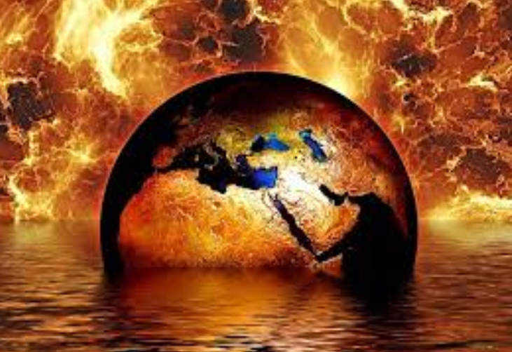
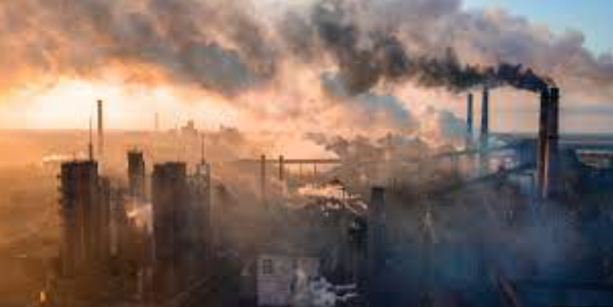


EFFECT ON HEALTH
Extreme Heat
Air quality
Waterborne diseases
Mental health

Slide 10

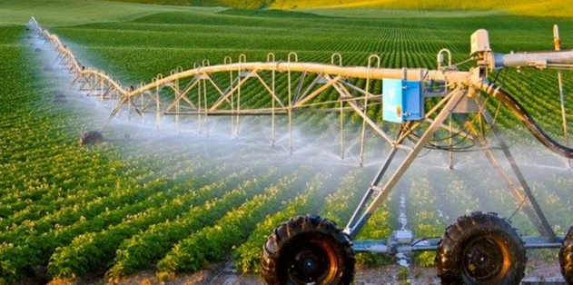

WAYS TO PREVENT FROM CLIMATE CHANGE
Restore nature
Reduces plastic
Improve farming
Invest in renewable energy
Electric vehicles
Climate education

Slide 11
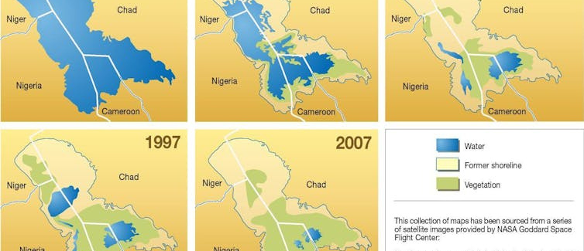
CASE STUDY OF CHAD’S CHANGING CLIMATE
The mid-20th century, temperatures in Chad have been increasing while rainfall is decreasing. Ninety percent of the country’s largest lake, Lake Chad has disappeared over the past 50 years due to a combination of droughts and increasing withdrawals for irrigation.

Slide 12
CHAD’S CHANGING CLIMATE
Rural areas are most at risk from climate change because that’s where most of the population and most of the poverty is found.
However, Urban areas are not safe either, as the country’s growing cities struggle to accommodate the arrival of new residents.
Sanitation services like sewage, storm water drainage and waste collection are poor, according to the World Bank.
In the event of floods as happened in 2010, 2011 and 2012, the infrastructure cannot cope and untreated sewage could infect the water supply, creating a high risk of infectious diseases such as cholera.

Slide 13

ACID RAIN

Slide 14
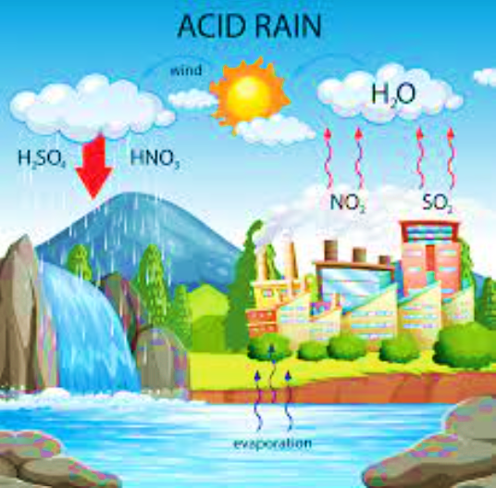
WHAT IS ACID RAIN?
Acid rain results when sulfur Dioxide (SO2) and nitrogen(NOx) Oxide are emitted to atmosphere and transported by wind. The SO2 and NOx react with water, Oxygen and other chemical to form sulphuric and nitric acid . These mix with water and come down with rain .
Equation Of Reaction
2SO2 (g) + O2 (g) + 2H2O (l) → 2H2SO4 (aq)
4NO2 (g) + O2 (g) + 2H2O (l) → 4HNO3 (aq)

Slide 15
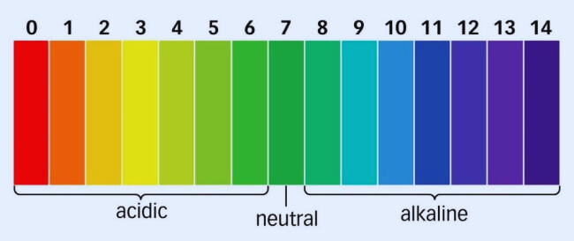
MEASUREMENT OF ACID RAIN
Acidity and Alkalinity are measured using a PH scale for which 7.0 is neutral.
The Ph of substance less than 7 are acidic and greater than 7 is alkaline in nature. Normal rain has a Ph of about 5.6; it is slightly acidic because of carbon dioxide dissolve into it forming weak carbonic acidic. Acid rain usually has Ph between 4.2 and 4.4 .

Slide 16
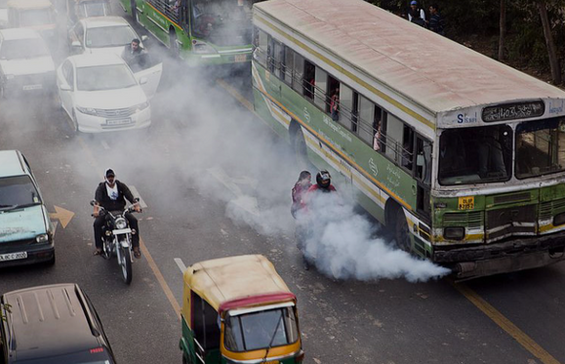
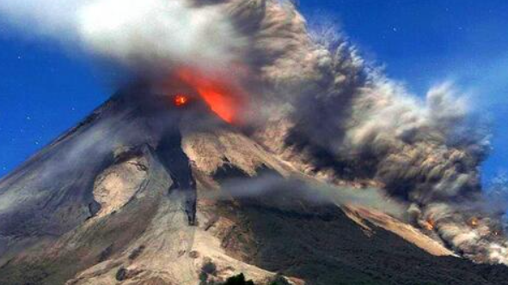
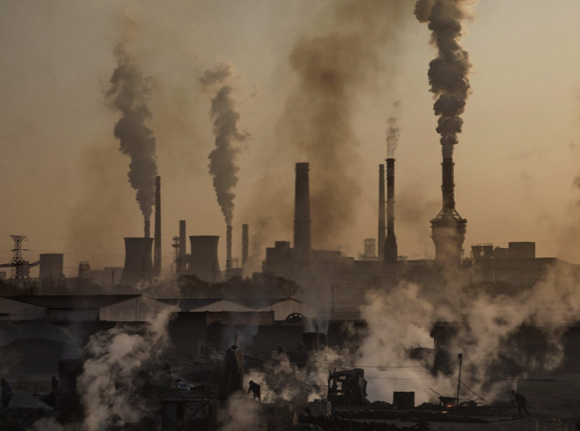
CAUSES OF ACID RAIN
01. Natural
Volcano eruptions
Natural fire etc.
02. Human Activites
Burning fossils fuels, manufacturing, oil refineries, electricity generation and vehicles all release Sulphur and nitrogen dioxide in atmosphere.

Slide 17
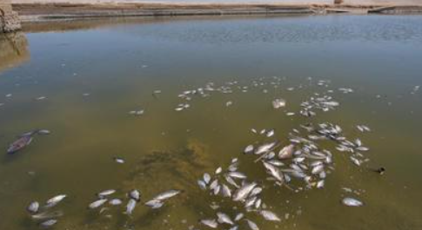
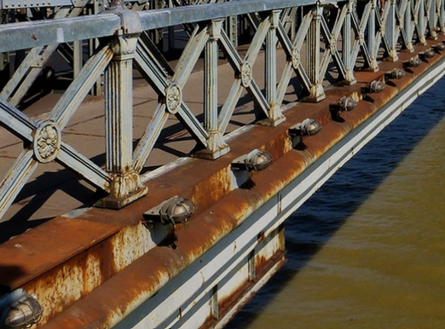
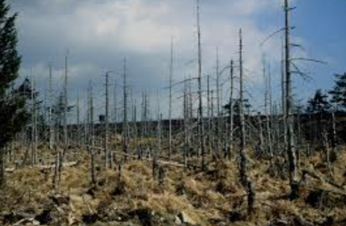
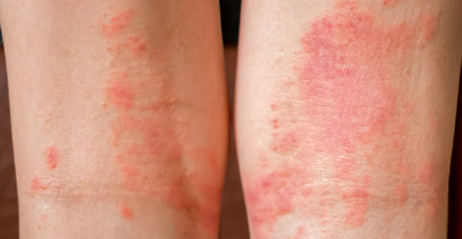
EFFECT OF ACID RAIN
01.
02.
Building material
03.
forest
04.
Human
Oceans
Ocean acidification
Destroy aquatic life- forms
Ruin building
Steel of bridges
statues
Increases acidity in soil
leeches nutrients from soil
Slowing plants growth
Destroy trees
Skin cancer
Respiratory diseases

Slide 18

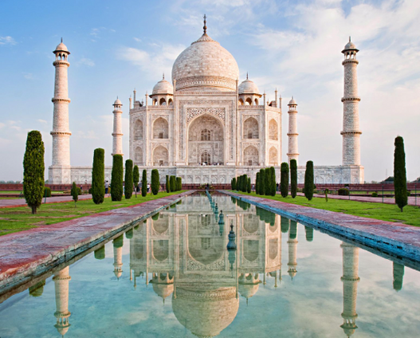
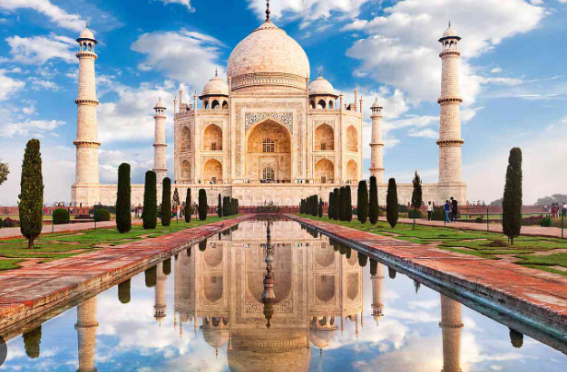
Case Study On Taj Mahal
Taj Mahal , one the 7 wonders of the world. It is largely affected by acid rain. The city of Agra has many industries and nitrogen in the atmosphere. The people continue to use low quality of coal and firewood as domestic fuel, adding to this problem. Acid rain has following reaction with the marble(calcium carbonate):
CaCO3(s) + H2SO4(l) → CaSO4(s) + H2O(l) + CO2(g)
The formation of calcium sulphate results in the corrosion of this beautiful monument.
BEFORE
AFTER

Slide 19
Case Study On Taj Mahal
The Supreme Court of India has taken several steps to save Taj Mahal. It has ordered the industries to switch to CNG and LPG.
The GOVERNMENT OF INDIA ANNOUNCED AN ACTION IN 1995 Including setting up of an air pollution monitoring station in Agra.
The supreme Court on 7/11/2000 while recommendations of the central pollution control Board directed that the four Ambient Air Quality monitoring Station be installed in Agra Region and these stations be run continuously for one year all the seven days in a week.

Slide 20

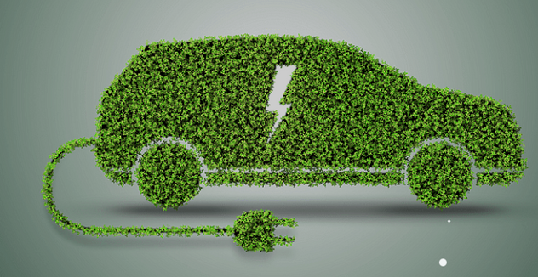
PREVENTION FROM ACID RAIN
01.
Filter and detoxify the water used by factories before returning it to the river.
02.
Reduced the emission of polluted gases by industries
03.
Promote innovation and new technologies aimed at optimizing energy consumption and developing renewable energy
04.
Plant more and more trees. (absorb air)
05.
Use of electric vehicles.
06.
Encourage the production and use renewable energy instead of fossil fuels.

Slide 21
CONCLUSION
The climate Change and Acid Rain are Global issues. We must work together to save our world. And our future depends on the action that we take today.

Slide 22
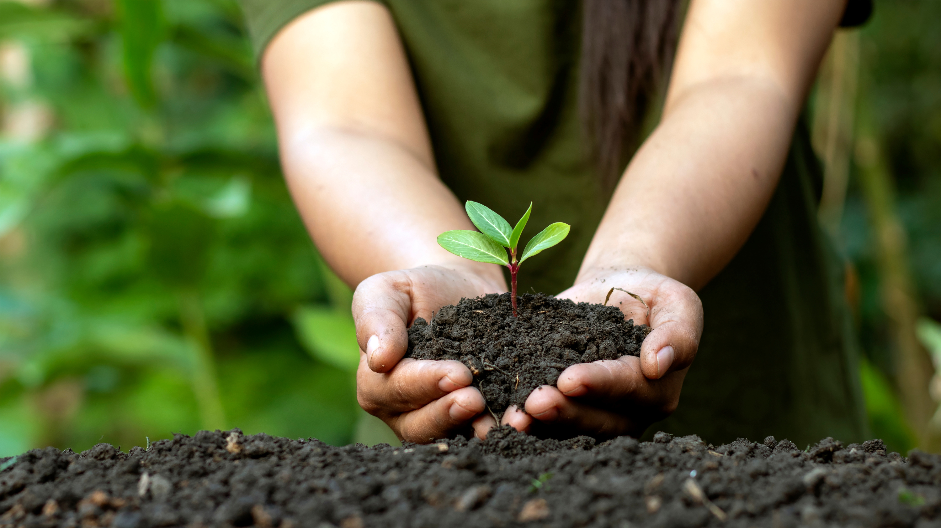

THANK
YOU

